Slide 1


PREDICTION OF BITCOIN PRICES USING MACHINE LEARNING
CS584 MACHINE LEARNING
INSTRUCTOR : DR. YAN YAN
Group - 48
Varun Anavatti (A20526745)
Narendra Kumar Srivastava (A20529845)
Shwedha Srinivasan (A20514543)

Slide 2
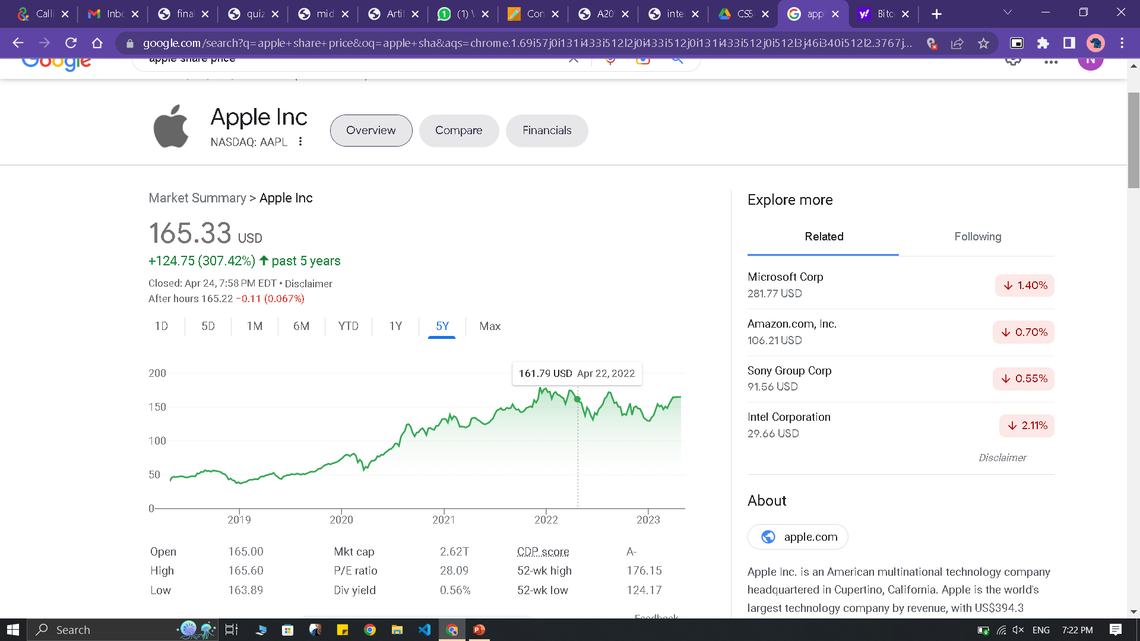
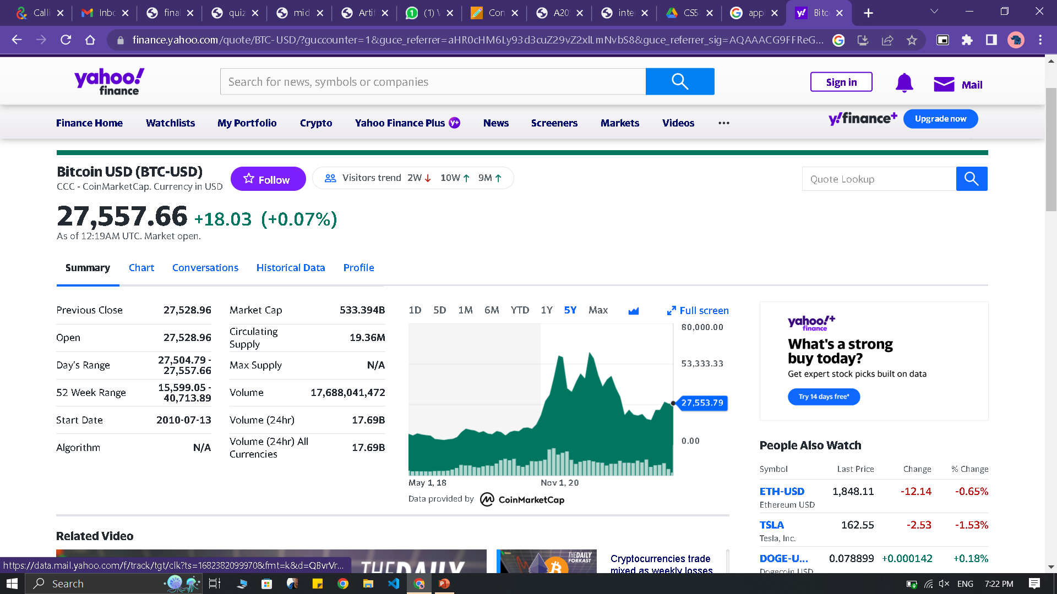
Why Bitcoin?
Apple: As of March 2023, Apple is the world's biggest company by market capitalization.
$97billion to $165billion
Bitcoin: the value of a bitcoin was 7,200.17 $in 2020 and just after two it was 47,686.81 $
This extreme growth and that too during a pandemic

Slide 3
INTRODUCTION
Making accurate predictions could result in substantial financial rewards for specific people
Due to their unique transaction structure, cryptocurrencies, especially Bitcoin, have recently grown in popularity among investors all over the world.
Bitcoin continues to be the biggest and most traded cryptocurrency, with a market share of over 55%, followed by Ethereum at 8.57%, despite the development of thousands of new cryptocurrencies.
Machine learning models can be trained to predict future Bitcoin prices by analyzing historical data and identifying patterns.
The availability of vast amounts of data and sophisticated machine learning algorithms have made it possible to create models that can provide reasonably accurate predictions.

Slide 4

The Problem
Cryptocurrencies are the most volatile markets today and has gained a lot of attentions form young investors around the globe. Cryptocurrency being a novel technique for transaction system, has been an unpredictable price fluctuation behavior. This led to a lot of confusion among the investor to invest their money in new era currencies or not. The bitcoin is said to be the most sought cryptocurrency is highly volatile as mere whisper on social media, market has significant affects on the prices of cryptocurrencies. The goal of this project is to predict prices for bitcoin using machine learning techniques for the next day and to maximize the gains of the investors.

Slide 5
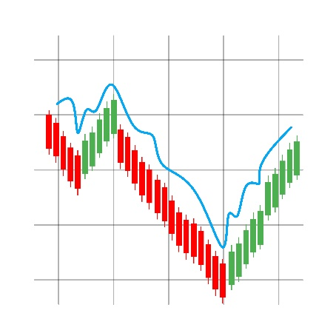
Problem Description ?
The main problem addressed in Bitcoin price prediction using machine learning is how to accurately predict the future price of Bitcoin.
It is a highly volatile and unpredictable cryptocurrency, and its price movements are influenced by a wide range of factors, including supply and demand, market sentiment, news events, and regulatory changes.
The challenge in building a Bitcoin price prediction model is to identify the most relevant factors that impact Bitcoin prices and to develop a model that can accurately forecast future price movements.
This involves collecting and preprocessing a large amount of historical data, selecting appropriate features and algorithms, training and validating the model.

Slide 6
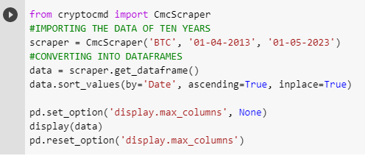
Data
Data used in this project is a real time data that we get from the cmcscraper. cmcscraper is a Python package that is primarily used for scraping cryptocurrency market data from the CoinMarketCap (CMC) API. The package provides a simple and easy-to-use interface for querying various endpoints of the CMC API, such as cryptocurrency prices, market capitalization, trading volume, and more.
WHERE DO WE GET THE DATA FROM?
The cmcscraper package in Python is a third-party library that allows users to easily retrieve cryptocurrency market data from the CoinMarketCap (CMC) API. It provides a simple interface for querying various endpoints of the CMC API, including cryptocurrency prices, market capitalization, trading volume, and more.

Slide 7
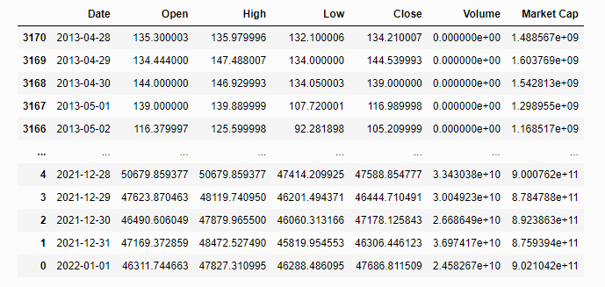
Data Collection and Preparation
Gather relevant data on Bitcoin
price and related variables such as trading volume, market capitalization,
and sentiment indicators.
Preprocess the data to remove noise and missing
values, and prepare it for use in machine learning models.

Slide 8
Description of the data
Below is a brief description of the data being used in the project.
Date: Date of the record.
Open: The opening price, the price at which Bitcoin trades at the beginning of the day. (USD).
High: The maximum price of the day, the highest price reached by Bitcoin on that day, (USD).
Low: The minimum price of the day, the lowest price reached by the Bitcoin on that day, (USD).
Close: The closing price, the price at which Bitcoin trades at the end of the day, (USD).
Volume: The sum of actual trades made during the day, (USD).
Market Cap: Market capitalization, the total value of all shares of a company or, in the case of Bitcoin, or of all coins in circulation, (USD).

Slide 9
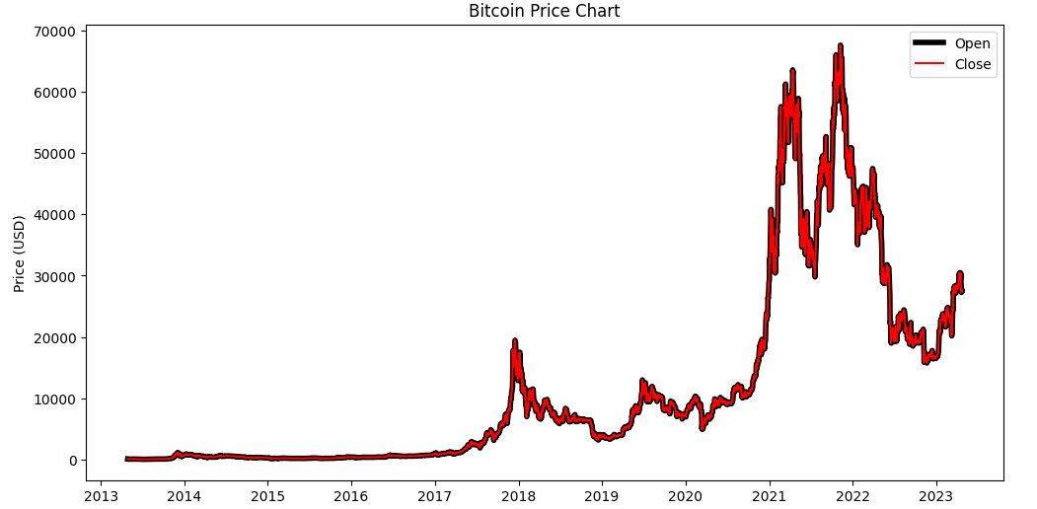
Time Series Data Visualization

Slide 10
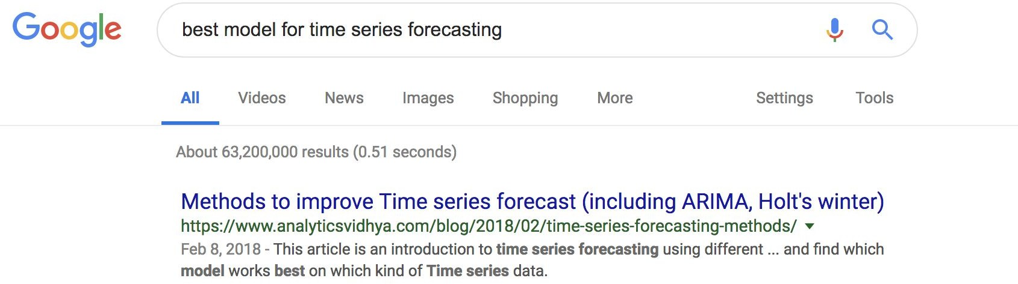
Lets find out ourselves!!!
Googling for the best model to use?...................Um NO!
AR
MA
ARIMA
LINEAR, LASSO,
MULTI-PERCEPTRON,
RANDOM FOREST
Random Forest
Linear Regression

Slide 11
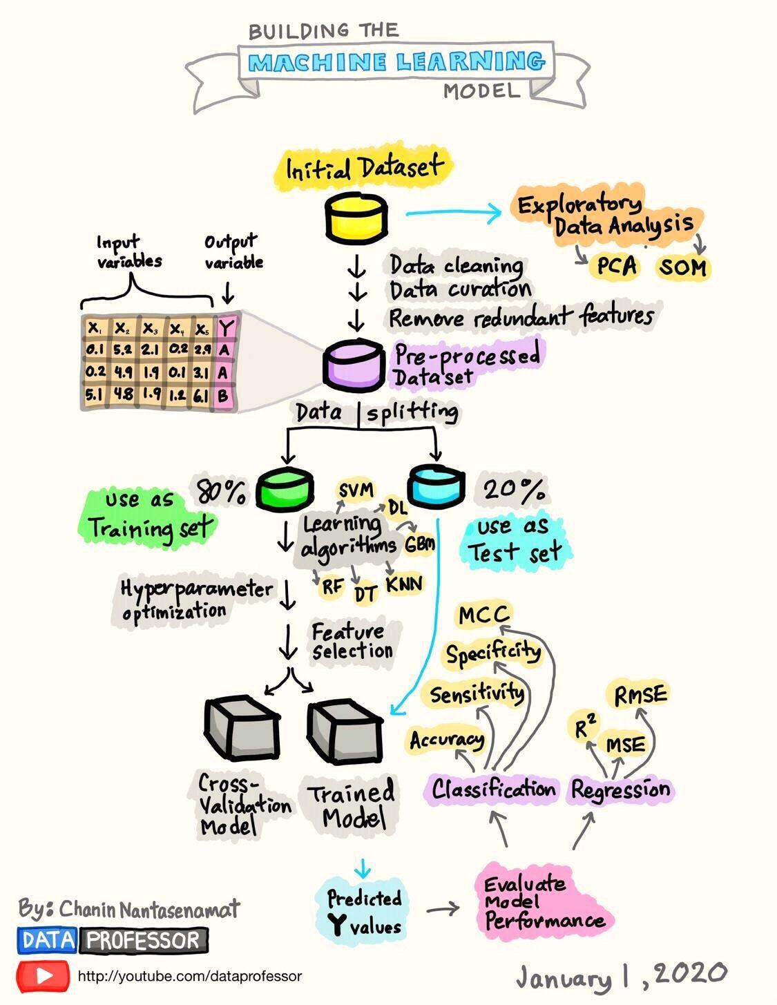
Machine Learning Algorithms Used
REGRESSION MODELS
(LINEAR, LASSO,
MULTI-PERCEPTRON,
RIDGE, RANDOM FOREST)
NEURAL NETWORKS
(AR, MA, ARIMA, LSTM)

Slide 12
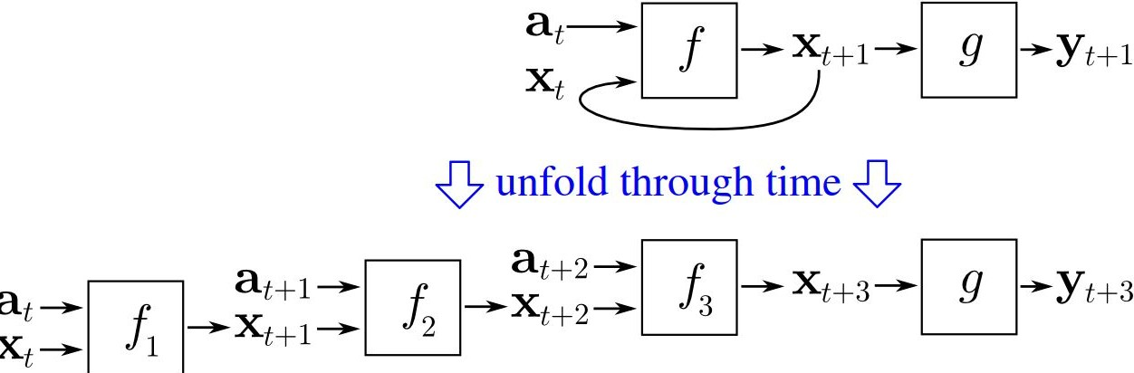
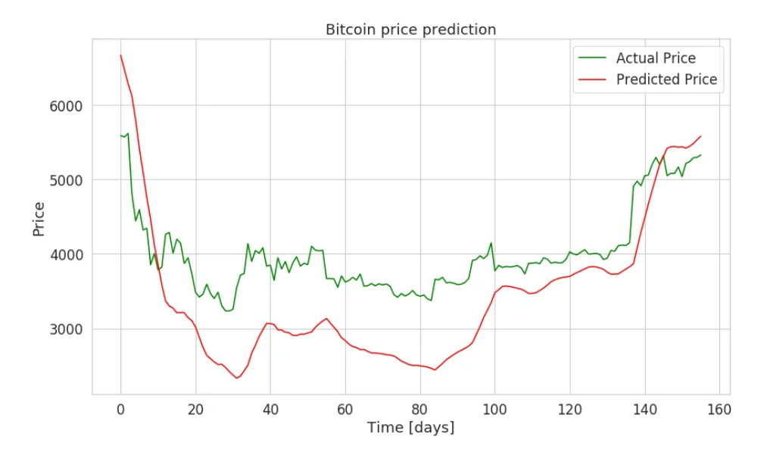
Deep RNN (Recurrent Neural Networks) with LSTM
2 Layers with 230 LSTM
Our model seems to do well on the test data.

Slide 13
WHAT IS ARIMA ??
AR: Autoregression dependent relationship between some number of lagged observations.
I: Integrated. To make the data stationary
MA: Moving Average. A model that uses the dependency between an observation and a residual error from a moving average model applied to lagged observations.

Slide 14
Testing the Stationarity
Augmented Dicky Fuller Test (ADF ):
The Augmented Dicky Fuller test is a type of statistical test called a unit root test.
The intuition behind a unit root test is that it determines how strongly a time series is defined by a trend.
There are numbers of unit root tests available and ADF is one of the most widely used
1. Null Hypothesis (H0): Null hypothesis of the test is that the time series can be represented by a unit root that is not stationary.
2. Alternative Hypothesis (H1): Alternative Hypothesis of the test is that the time series is stationary.

Slide 15
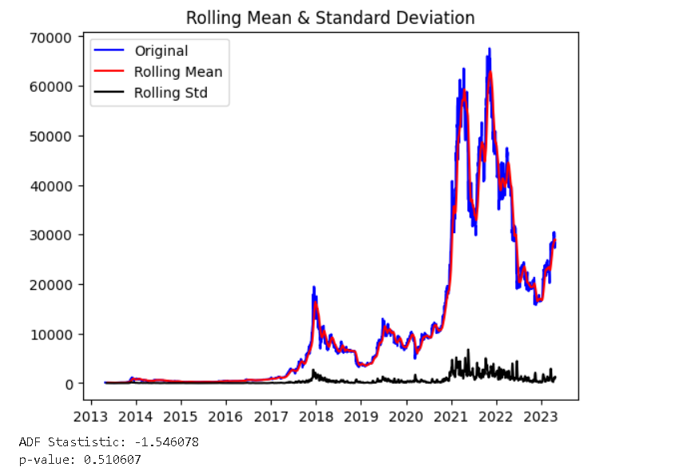
Augmented Dicky Fuller Test (ADF ):
Since the p value is greater than 0.05.
the time series is non stationary. there is some work that needs to be done here. So now we use transformations to make the series stationary.

Slide 16
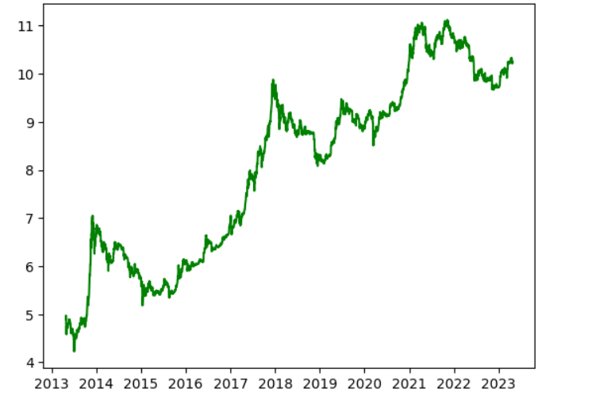
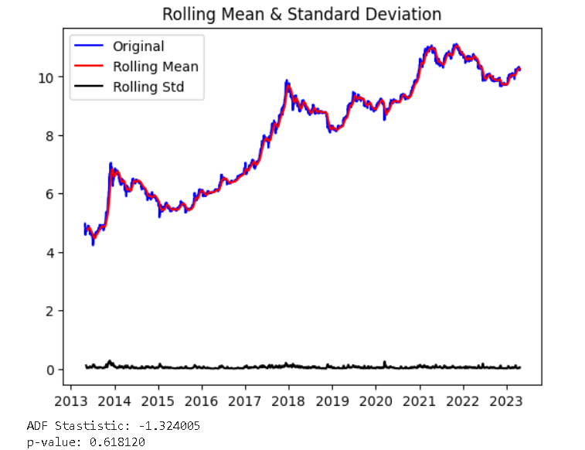
Log Transforming the series Log transformation is used to unskew highly skewed data. Thus helping in forecasting process.
The series is still non stationary as p value is still greater than 0.05 so we need to make further transformations. So let’s go ahead with differencing.

Slide 17
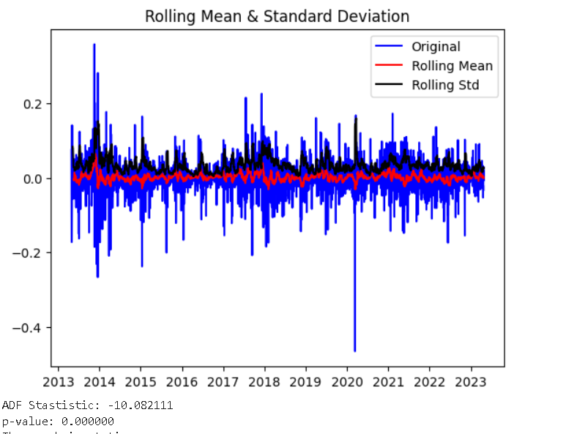
Remove trend and seasonality with differencing
In case of differencing to make the time series stationary the current value is subtracted with the previous values. Due to this the mean is stabilized and hence the chances of stationarity of time series are increased.
As our time series is now stationary as our p value is less than 0.05 therefore we can apply time series forecasting models.
Interpretation of p value:
1. p value > 0.05: Accepts the Null Hypothesis (H0), the data has a unit root and is non-stationary.
2. p value < = 0.05: Rejects the Null Hypothesis (H0), the data is stationary.

Slide 18
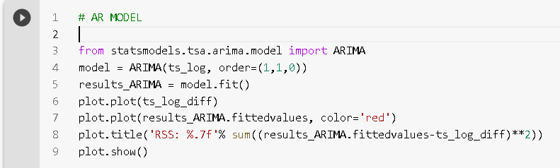
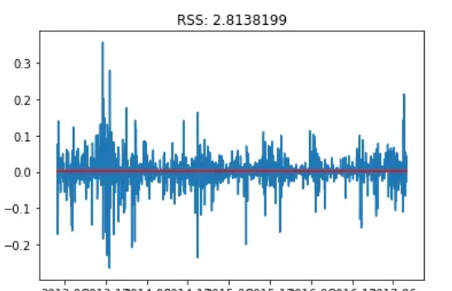
Auto regressive model is a time series forecasting model where current values are dependent on past values.
Auto Regressive model

Slide 19
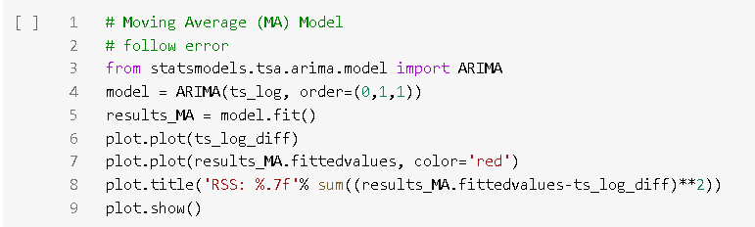
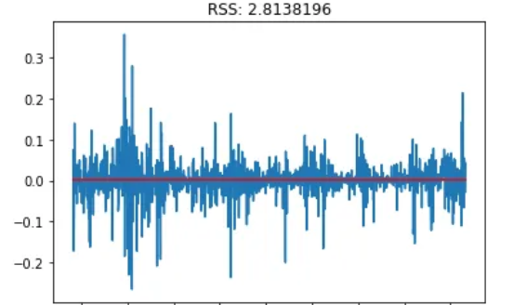
In moving average model the series is dependent on past error terms.
Moving Average Model

Slide 20
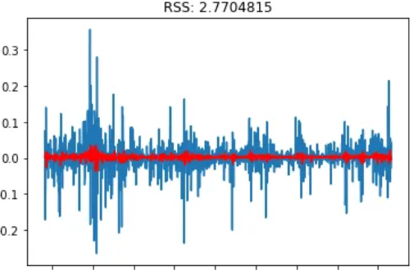
Auto Regressive Integrated Moving Average Model
It is a combination of both AR and MA models. It makes the time series stationary by itself through the process of differencing. Therefore differencing need not be done explicitly for ARIMA model
Thus we see that the RSS (Residual Sum of Squares) error is minimum for ARIMA model. Therefore ARIMA model is the best among the three models because of use of dependence on both lagged values and error terms.

Slide 21
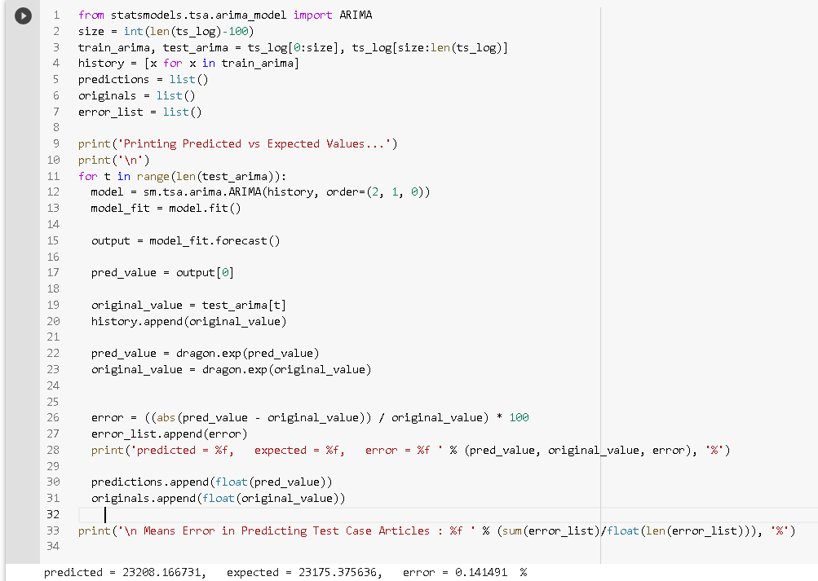
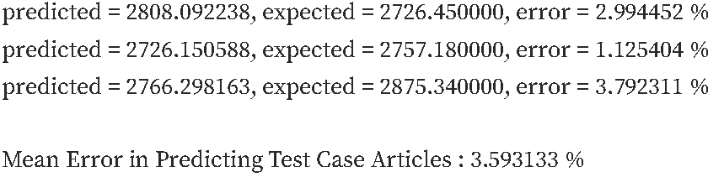
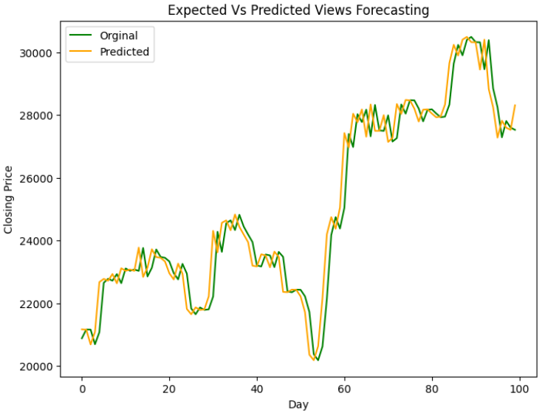
For every value in the test we apply an ARIMA model and then the error is calculated and then after iterating over all values in the test set the mean error between predicted and expected value is calculated.

Slide 22
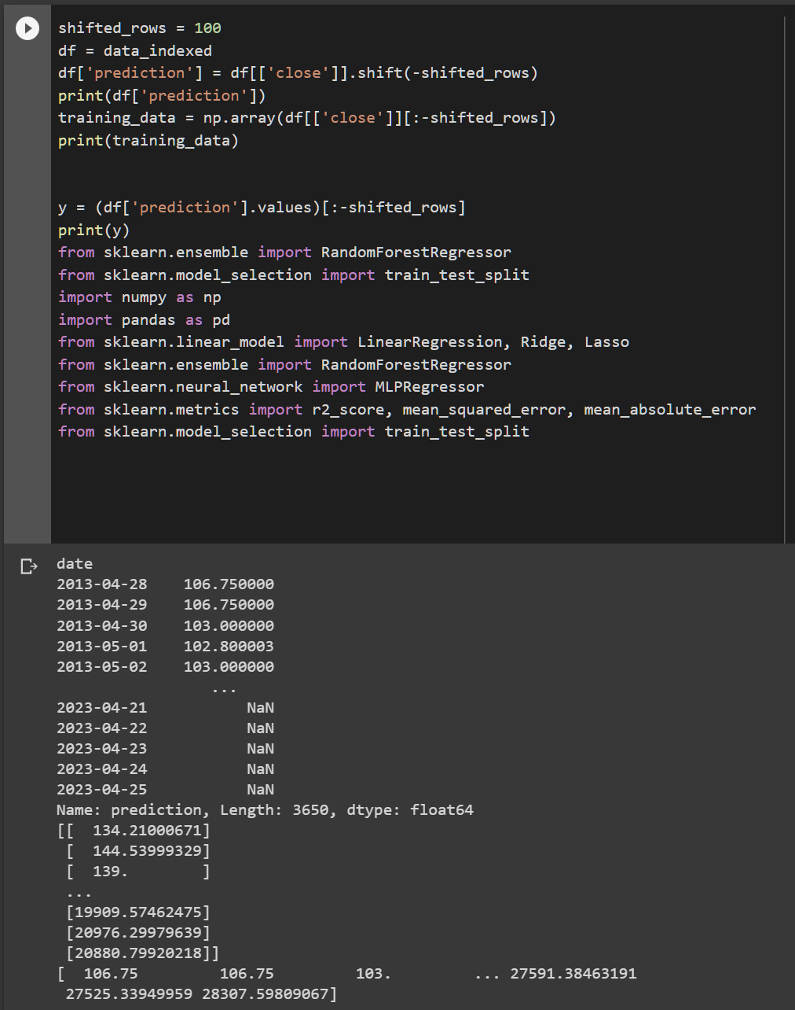
REGRESSION MODELS
Various regressors models are used, but all of them are more or less of the same accuracy.
In order for the predicting the bitcoin prices for the next 100 days, we put it as a separate dataset.
Today, the bitcoin price is approximately 28,400$, the regression models have predicted around 21,000$.
The next upcoming slides explain the various comparisons of regressors, on the basis of metrics and graphs.

Slide 23
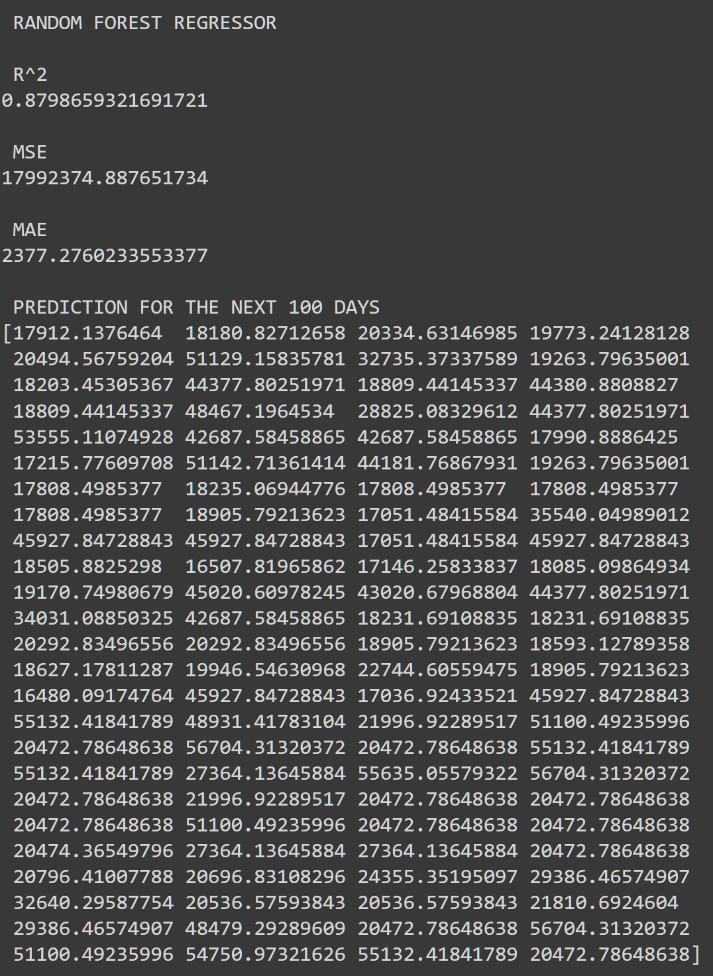
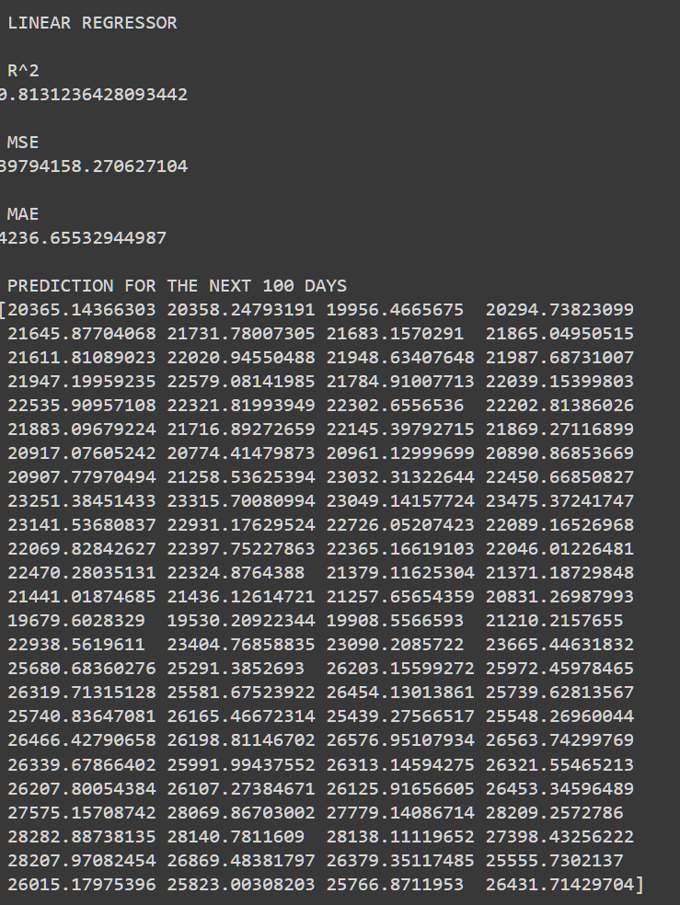
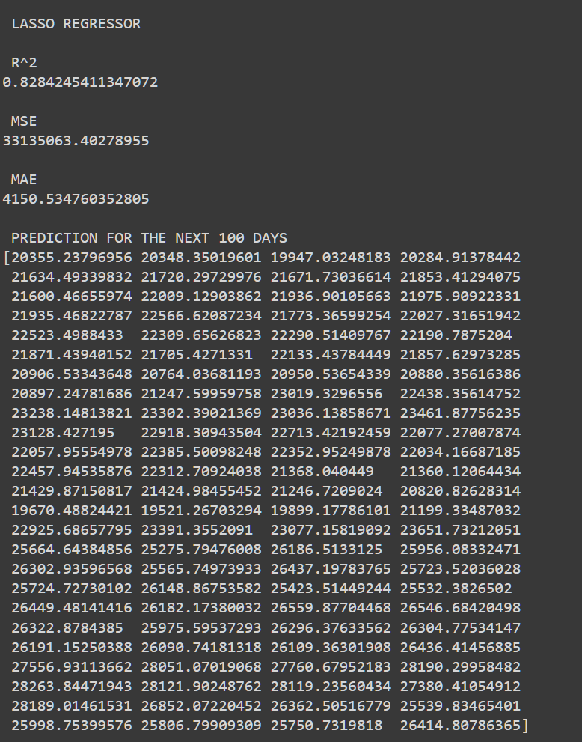
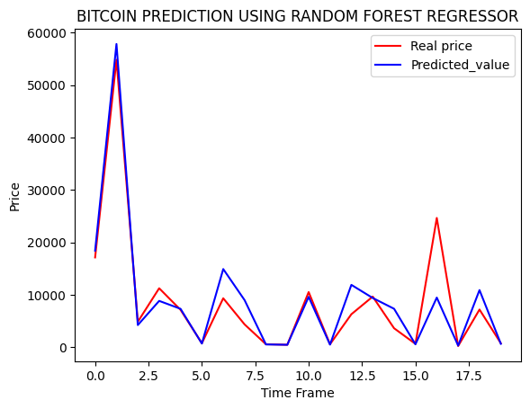
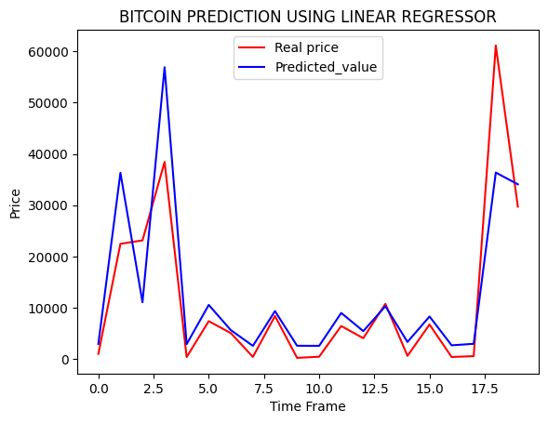
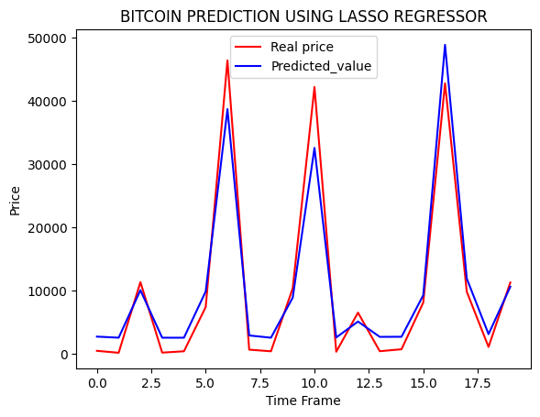

Slide 24
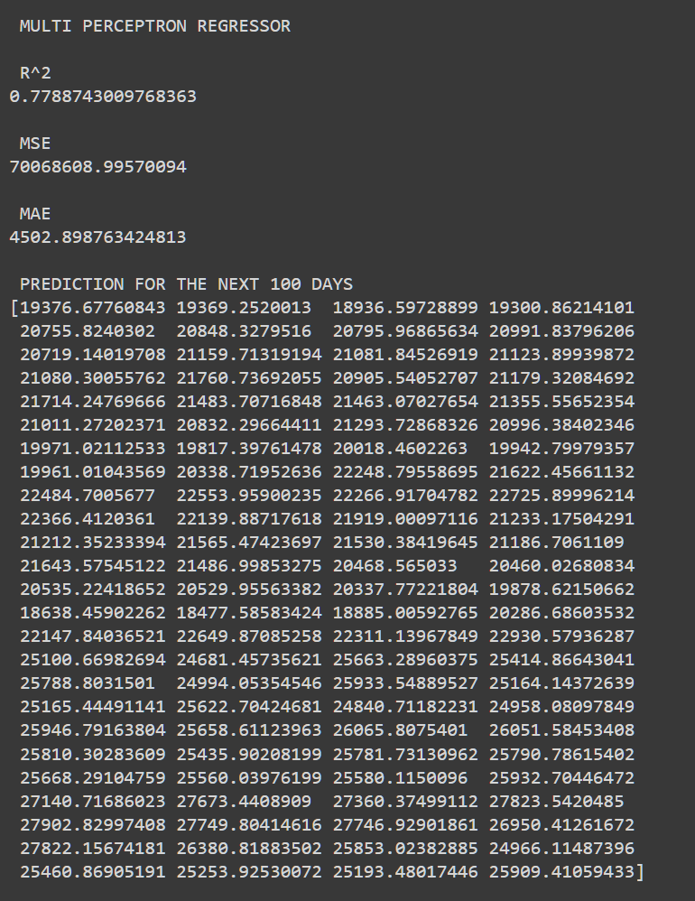
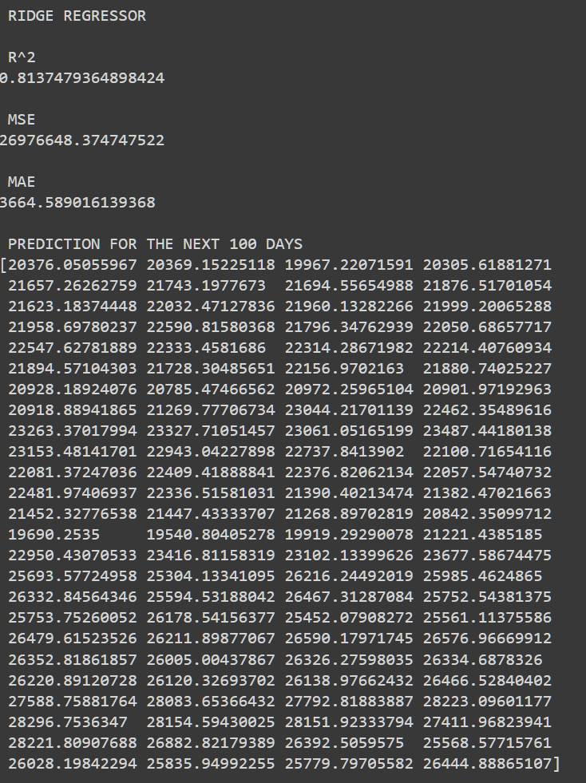
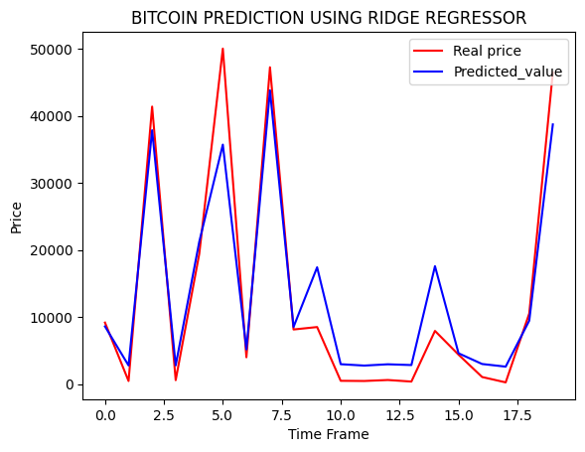
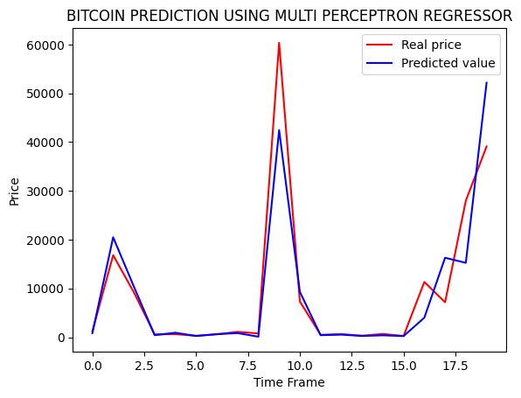

Slide 25

Conclusions and Future Work
Feature Engineering and data augmentation can be added to improve the accuracy.
Sentiment based data can also be added.
More new models can be used (including regressor, classifier and nueral networks).

Slide 26

THANK YOU

